Slide 1
Multithreaded Programming (Java)

Slide 2
Objectives.
Appreciate the (increasing) importance of parallel programming
Understand fundamental concepts:
Parallelism, threads, multi-threading, concurrency, synchronization etc.
See some basics of how this is done in Java
See some common uses:
Parallel Search in an Array.

Slide 3
Introduction
Thread: “single sequential flow of control within a program”
Its ‘lighter’ than a process
smallest unit of processing that can be scheduled by an operating system
Has its own run-time call stack, copies of the CPU’s registers, its own program counter, etc.
Process has its own memory address space, but threads share one address space.
A single program can be multi-threaded
Time-slicing done just like in multiprocessing

Slide 4
Two Ways of creating threads
1.Extending Thread Class.
run() method must be overridden (similar to main method of sequential program)
run() is called when execution of the thread begins .
A thread terminates when run() returns.
start() method invokes run().
Calling run() does not create a new thread.

Slide 5
Two Ways of creating threads(contd..)
2.Implementing Runnable Interface.
Implement java.lang.Runnable interface
If already inheriting another class (i.e., JApplet)
we cannot extend Thread Class.(Java does not support multiple Inheritance directly)
Single method: public void run() must be implemented.
Thread class implements Runnable.

Slide 6
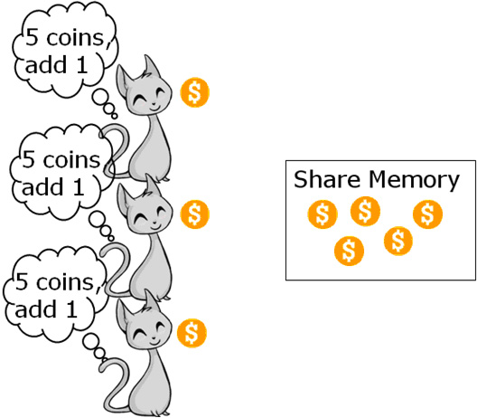
Thread Synchronization.
When multiple threads try to access a shared memory location synchronization is required.
Synchronization is needed to assure consistency of data.
Here is a program to demonstrate the problem:

Slide 7
Solution
There are Two Ways of synchronization:
1.Use Synchronized keyword on the shared variable methods.
This Will make sure that only one thread is executing that method at a single unit of time.
Program:

Slide 8
2.Using Synchronized Block
If we do not have access to the methods of the shared object we can use this mechanism.
Declare a Synchronized block around the code to access the shared object in our Thread Class.
synchronized(acc)
{
for(int i=0;i<50000;i++)
acc.deposit(1);
}

Slide 9
Parallel Search.
We can make use of concurrent execution threads to divide the task among themselves. This will decrease the total time taken to do that task.
Assume that we were give an array and our program needs to search for an element within the array.
A sequential program will have a single thread accessing each element of the array one by one.
We can choose to launch multiple threads to do the same task and save some time.
The Algorithm that we choose to partition the work among the threads plays an important role in the speed of the program.

Slide 10
Sequential Search.
For loop used in a Sequential Search.
for(int i=0;i<array.length; i++)
{
if(array[i] == keyword)
return true;
}

Slide 11
The Parallel Way of ‘For loop’
The below for loop can be used to partition the task based on Round Robin Scheduling.
for(int i= threadID; i< array.length ; i= i + NO_OF_THREADS)
{
if(array[i] == keyword)
return true;
}
Every thread starts the task at i = threadID.

Slide 12
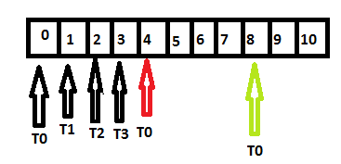
How it works
Suppose there are 4 Threads(ids 0-3).
Thread0 - starts at 0
Thread1 - starts at 1
Thread2 - starts at 2
Thread3 - starts at 3
Thread0 - continues at 4
Thread1 - continues at 5
Thread2 - continues at 6
Thread3 - continues at 7
Thread0 - continues at 8
…

Slide 13
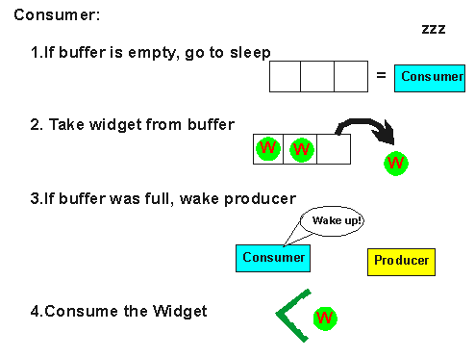
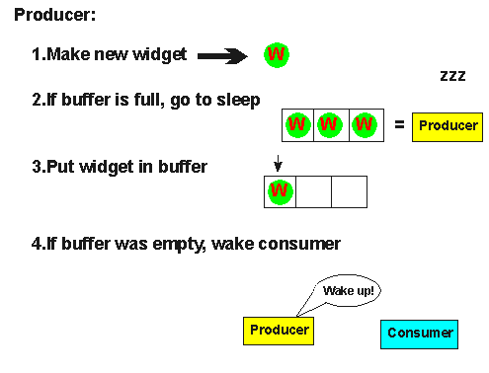
Additional Program: Producer Consumer Problem.
Here is a simpler version of program:

Slide 14
Advantages
Reactive systems – constantly monitoring
More responsive to user input – GUI
(A thread with count down timer can run in parallel with another thread responding to the input of user. )
A Program can handle multiple clients simultaneously.
Can take advantage of parallel processing.

Slide 15
THE END.

